Slide 1
Formal Aspects of Strategic Reasoning in MAS
Aniello Murano
Università di Napoli Federico II
Vardi Fest 2022
Haifa, Israel – 31 July 2022

Slide 2
In September 2000…
Mail to: Prof. Moshe Y. Vardi
Subject: Visiting scholar
Dear Professor Moshe Y. Vardi,
My name is Aniello Murano, I am a PhD student at the University of Salerno, working under the supervision of Prof. Margherita Napoli.
My research interests mainly concerns theory of automata, temporal logics and model checking.
I would like to spend a period at Rice University as a visiting scholar, working under your supervision […]
A few hours later:
Mail to: Aniello Murano
Subject: Re: Visiting scholar
I’d be happy to host you!
Moshe
☺ ☺ ☺

Slide 3
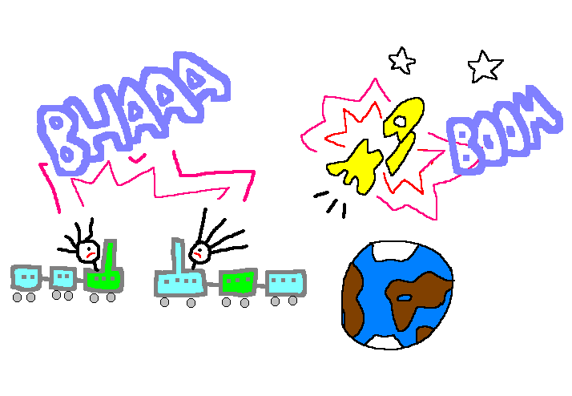
Model Checking
Formal Verification 1.0
Let S be a finite-state system and P its desired behavior
S → labelled state-transition graph M
P → a temporal logic formula ψ
The system has the required behavior
Is the system correct?
M satisfies ψ
* Courtesy of Orna

Slide 4
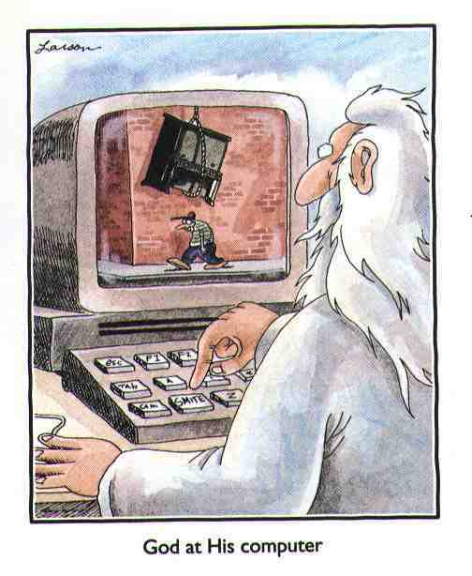
Classes of Models [2001]
Closed Systems
Behavior is fully characterized by system state
Open Systems
Behavior depends on the interaction with the environment
Open System Model: Labelled State-Transition Graph
A solution for Open Finite-State Systems: Module Checking [Kupferman, Vardi, Wolper 1996-2001]
It must be “reactive”
Formal Verification 2.0!

Slide 5
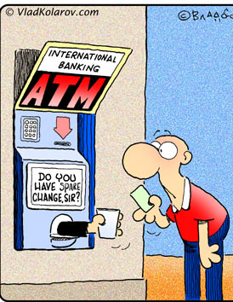
Module checking
Module M: Kripke structure with a partition into sys and env states
An environment behaviour corresponds to a pruning of some env successor states
M (reactively) satisfies the spec φ if all such environment behaviours do it
Consider the ATM machine as an open system:
Displays a welcome screen
Lets the environment choose to view an Ad or withdraw money
Performs the requested operation and restarts from 1
Module checking
M ⊨_{r} φ
Withdraw
M:
Welcome
Choose
sys
Open
system
sys
env
Show Ad
sys

Slide 6
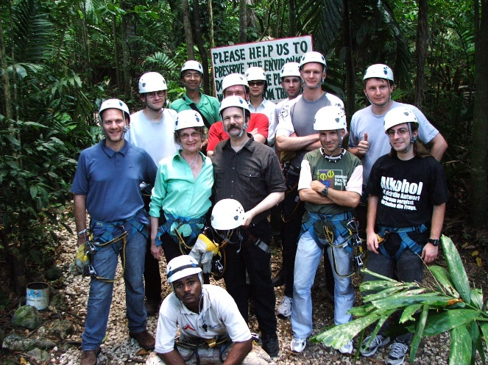
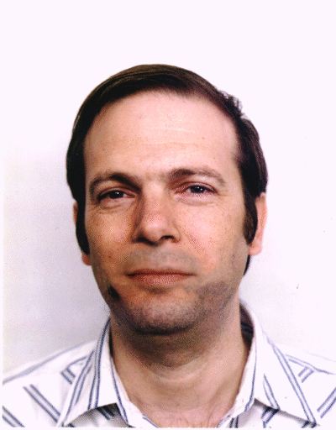
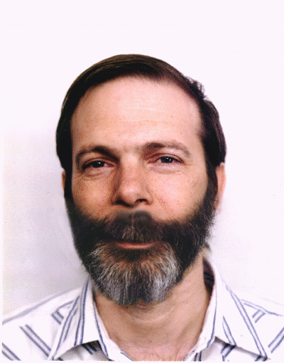
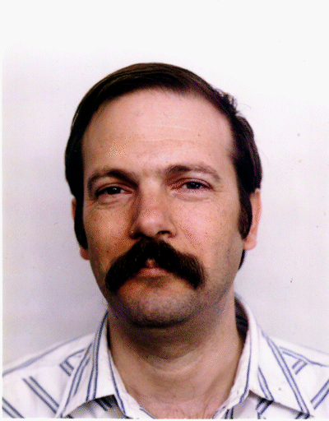
LPAR 2005 – Jamaica
Infinite-state open system verification
Pushdown Module checking
Moshe, question: What about imperfect information? ☺☺
Main result: Decidable but exponentially harder than Model Checking
Formal Verification 3.0!
Main result: Undecidable! With partial observability only on local states: Decidable!

Slide 7
In 2008
…”You take the red pill... you stay in Wonderland, and I show you how deep the rabbit hole goes” – Morpheus (The Matrix)
…
It is time to move to Multi-Agent Systems…
Strategy Logic
Moshe (2009): “This is an important project. Let us put all our strength into it!”
Fabio Mogavero
Sasha Rubin
Giuseppe Perelli
Bastien Maubert
Luigi Sauro
Alessandro Bianco
Benjamin Aminof
Raphaël Berthon
Vadim Malvone
Loredana Sorrentino
Petr Cermak
Alessio Lomuscio
Francesco Belardinelli
Michael Wooldridge
Marta Kwiatkowska
Wojciech Jamroga
Damian Kurpiewski
Catalin Dima
Nathanaël Fijalkow
Julian Gutierrez
Patricia Bouyer
Orna Kupferman
Nicolas Markey
Olivier Serre
Giuseppe De Giacomo
Munyque Mittelmann
Laurent Perrussel
Sophia Knight
Martin Zimmerman
Daniel Neider
…. . . and many others

Slide 8
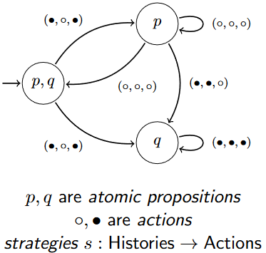
Strategy Logic (SL)
The Model: A Concurrent Game structure.
Transitions depend on agents’ collective actions
The Logic (SL):
LTL + ∃s.φ “there exists a strategy s such that φ” (a, s)φ “when player a plays strategy s, φ”
Insight. Strategies are treated as first order objects and associated to agents by bindings.
An example: - (∃ s₁)(∀ s₂)(∃ s₃)(a_{i} → s_{i}) Fp “a₁ has a strategy to beat any a₂’s strategy with an a₃’s counter-strategy”
Mogavero, M., Perelli, Vardi: Reasoning About Strategies: On the Model-Checking Problem. TOCL 2014 (preliminary results in FSTTCS 2010). ~500 citations

Slide 9
SL: Features, results, and impact
Natural and very expressive, much beyond all previous formalisms!
Bridges FM, AI, and economic game-theory.
Tools on SL have been developed and used in practice
Extended in several directions: probabilistic, fuzzy, pushdown, mechanism design, imperfect information (public action/hierarchical visibility).
Future directions: More work to make SL suitable in practice. Improving existing tools Work on approximation and learning-integration

Slide 10
When I left Rice…
Moshe:
“It is not important how strong your theory is, but rather how strong your supervisor is”!

